Slide 1
Numerical methods for Chemical Engineers: Non-linear equations
Prof.dr.ir. Martin van Sint Annaland Dr.ir. Ivo Roghair
Chemical process Intensification

Slide 2
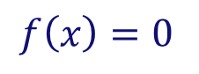
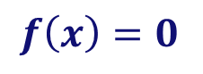
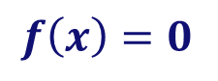
Content
How to solve:
One dimensional case:
“Bracket or ‘trap’ a root between bracketing values, then hunt it down like a rabbit.”
Multi-dimensional case:
N equations in N unknowns: You can only hope to find a solution. It may have no (real) solution, or more than one solution!
Much more difficult!! “You never know whether a root is near, unless you have found it”
$$f\left(x\right)=0$$
for arbitrary functions f
“Root finding”
(i.e. move all terms to the left)
$$f\left(x\right)=0$$
$$f\left(x\right)=0$$

Slide 3
Outline
One-dimensional case:
Bisection method
Secant and false position method
Brent’s method
Newton-Raphson method
Multi-dimensional case:
Newton-Raphson method
Broyden’s method
Do not use routines as black boxes without understanding them!!!
Introduction to underlying ideas and algorithms
Exercises in how to program the methods in Excel and MATLAB.

Slide 4
General idea
Root finding proceeds by iteration:
Start with a good initial guess (crucially important!!)
Use an algorithm to improve the solution until some predetermined convergence criterion is satisfied
Pitfalls:
Convergence to the wrong root…
Fails to converge because there is no root…
Fails to converge because your initial estimate was not close enough…
Hamming’s motto: the purpose of computing is insight, not numbers!!
It never hurts to inspect your function graphically
Pay attention to carefully select initial guesses

Slide 5
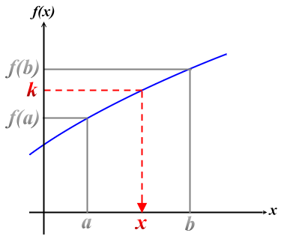
Bracketing
Bracketing a root = knowing that the function changes sign in an identified interval
f(x)
A root is bracketed in the interval (a,b), if f(a) and f(b) have opposite signs
a
b
⇒ At least one root must lie in this interval, if the function is continuous
Intermediate Value Theorem If f(x) is continuous on [a,b] and k is a constant that lies between f(a) and f(b), then there is a value x∈[a,b] such that f(x) = k

Slide 6
Bracketing
Bracketing a root = knowing that the function changes sign in an identified interval
f(x)
a
b
General best advise:
Always bracket a root before trying to converge…
Never allow your iteration method to get outside the best bracketing bounds…

Slide 7
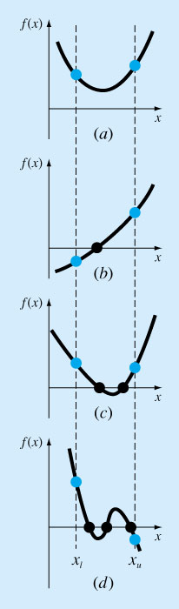
General idea
Examples of pitfalls of bracketing…
No answer (no root)
Oops!! (two roots!!)
Nice case (one root)
Three roots (might work for a while!)

Slide 8
Bracketing
Exercise 1:
Write a function in MATLAB to bracket a function given an initial guessed range x₁ and x₂. (via expansion of the interval)
Write a program to find out how many roots exist (at minimum) in the interval x₁ and x₂.
Of course these functions can then be combined to create a function that returns bracketing intervals for different roots.

Slide 9
Passing functions in Matlab
In MATLAB function names can be passed as arguments to functions, this is called a function handle (other programs would call this pointer).
For example: to solve f(x) = x² − 4x + 2 = 0 numerically, we can write a function that returns the value of f:
The function handle can be used as an alias
We can then call a solving routine (e.g. fzero):
function f = MyFunc(x) f = x^2 – 4*x + 2;
return
(Note: case sensitive!!)
>> f = @MyFunc; a = 4; b = f(a)
>> ans = fzero(@MyFunc,5)
>> fzero(@(x) x^2-4*x+2,5)

Slide 10
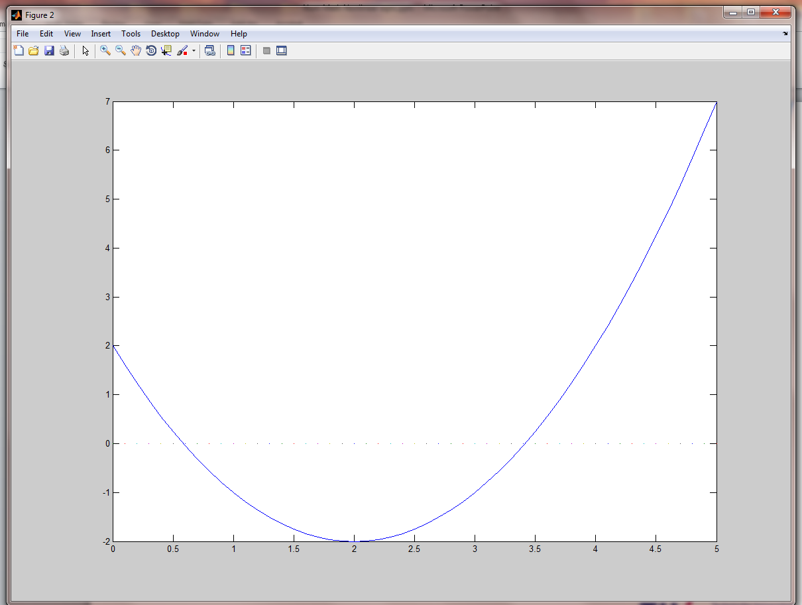
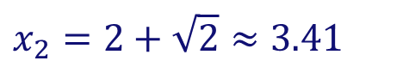
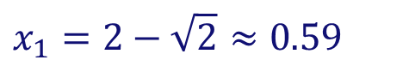
Bracketing
Exercise 1: Function to bracket a function
If possible, first make a graph: for example via
>> x=0:0.1:5;
>> y=x.^2-4*x+2;
>> figure;
>> plot(x,y,x,0);
Makes immediately clear that there are two roots.
$$x_{1}=2−\sqrt{2}≈0.59$$
$$x_{2}=2+\sqrt{2}≈3.41$$

Slide 11
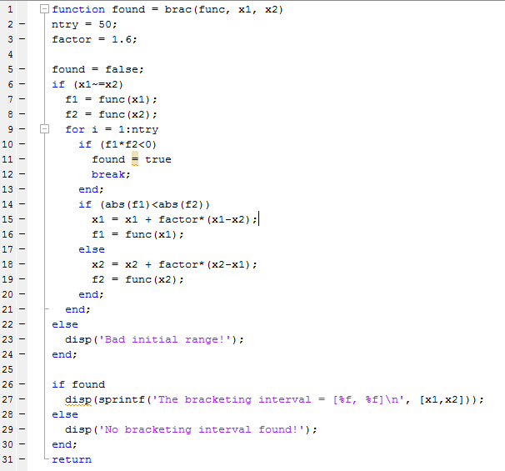
Bracketing
Exercise 1: Function to bracket a function
a function to expand the interval (x₁,x₂) maximally 2⁵⁰ ~ 10¹⁵, untill a root is found
returns true when root is found and false otherwise
displays results

Slide 12

Bracketing
Exercise 1: Function to bracket a function
a function to subdivide the interval (x₁,x₂) in n parts and examines whether there is at least one root
Returns the left and right boundaries of the intervals of the roots in xb1, xb2

Slide 13
Bisection method
Bisection algorithm:
Over some interval it is known that the function will pass through zero, because the function changes sign
Evaluate function value at the interval’s midpoint and examine its sign
Use the midpoint to replace whichever limit has the same sign
4
2
f(x)
5
It cannot fail, but relatively slow convergence!
a
b
3
1

Slide 14
Bisection
Exercise 2:
Write a function in Excel to find a root of a function using the bisection method
Assume that an initial bracketing interval (x₁, x₂) is provided
Also the required tolerance is specified (which tolerance?)
Also output the required number of iterations
Do the same in MATLAB

Slide 15
Bisection method
Exercise 2: Bisection method in Excel
=IF(f1*fmid<0;x1;xmid)
=IF(f2*fmid<0;x2;xmid)
xmid = 0.5*(x1 + x2)
fmid = f(xmid)

Slide 16
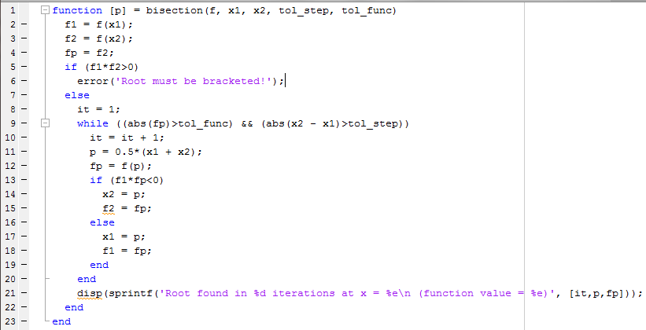
Bisection method
Exercise 2: Bisection method in MATLAB
Note1: We have used a criterion for the function value and the step size!
Note2: usually while loop needs protection for maximum number of iterations (but here bisection is sure to convergence…)
Root found in 25 iterations required. Can we do better?
>> bisection(@(x) x^2-4*x+2,0,2,1e-7,1e-7);

Slide 17
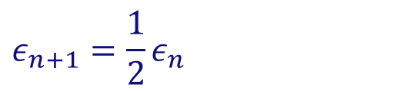



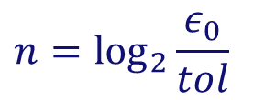
Bisection method
Required number of iterations?
After each iteration the interval bounds containing the root decrease by a factor of 2:
Order of convergence = 1
Must succeed:
More than root ⇒ bisection will find one of them
No root, but singularity ⇒ bisection will find singularity
$$ε_{n+1}=\frac{1}{2}ε_{n}$$
$ε_{0}=$
$$n=\log_{2}{\frac{ε_{0}}{tol}}$$
initial bracketing interval
⇒
$tol=$
desired tolerance
i.e. after 50 iterations the interval is decreased by factor 2⁵⁰ = 10¹⁵!
(Mind machine accuracy when setting tolerance!)
$$ε_{n+1}=K{\left(ε_{n}\right)}^{m}$$
m = 1: linear convergence
m = 2: quadratic convergence

Slide 18
Secant and False position method
Secant/False position (= Regula Falsi) method
Faster convergence (provided sufficiently smooth behaviour)
Difference with bisection method in choice of next point:
Bisection: mid-point of interval
Secant/False position: point where the approximating line crosses the axis
One of the boundary points is discarded in favor of the latest estimate of
Secant: retains the most recent of the prior estimates
False position: retains prior estimate with opposite sign, so that the points continue to bracket the root

Slide 19
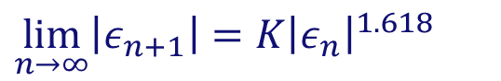
Secant and False position method
Secant method
False position method
2
2
f(x)
f(x)
3
3
5
5
4
a
b
a
b
4
1
1
Secant: slightly faster convergence:
False position: guaranteed convergence
$$\lim_{n→∞}\left|ε_{n+1}\right|=K{\left|ε_{n}\right|}^{1.618}$$

Slide 20
Secant and False position method
Exercise 3:
Write a function in Excel and MATLAB to find a root of a function using the Secant and the False position methods
Assume that an initial bracketing interval (x₁, x₂) is provided
Also the required tolerance is specified
Also output the required number of iterations
Compare the bisection, false position and secant methods

Slide 21
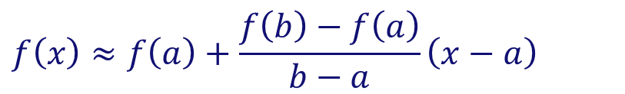
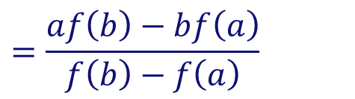

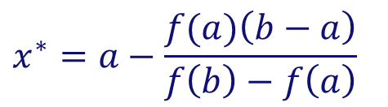
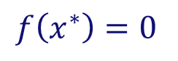
Secant and False position method
Exercise 3:
Determination of the abscissa of the approximating line:
Determine the approximating line:
Determine abscissa:
f(b)
$$f\left(x\right)≈f\left(a\right)+\frac{f\left(b\right)−f\left(a\right)}{b−a}\left(x−a\right)$$
f(x)
$$f\left(x^{∗}\right)=0$$
a
b
$$x^{∗}$$
$$x^{∗}=a−\frac{f(a)\left(b−a\right)}{f\left(b\right)−f\left(a\right)}$$
⇒
$$=\frac{af\left(b\right)−bf\left(a\right)}{f\left(b\right)−f\left(a\right)}$$
f(a)

Slide 22
Secant and False position method
Exercise 3: False position method in Excel
=IF(f1*fabsc<0; x1;xabsc)
=IF(f2*fabsc<0; x2;xabsc)
x absc = x1 – f1*(x2 – x1)/(f2 – f1)
f absc = f(x absc)

Slide 23
Secant and False position method
Exercise 3: Secant method in Excel
=min(x_{it-2},x_{it-1})
=max(x_{it-2},x_{it-1})
x absc = x1 – f1*(x2 – x1)/(f2 – f1)
f absc = f(x absc)

Slide 24
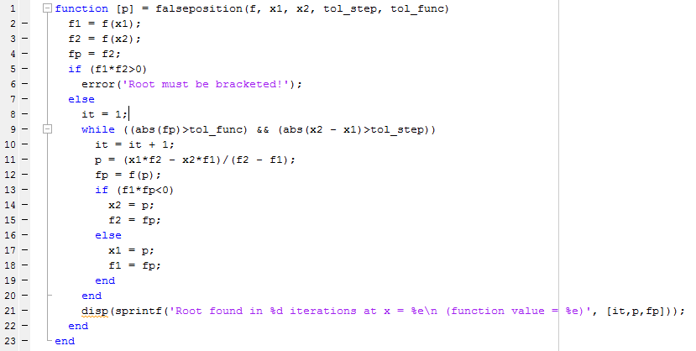
Secant and False position method
Exercise 3: False position method in MATLAB
The only difference with bisection!
Root found in 12 iterations! (Bisection needed 25 iterations)
>> falseposition(@(x) x^2-4*x+2,0,2,1e-7,1e-7);

Slide 25
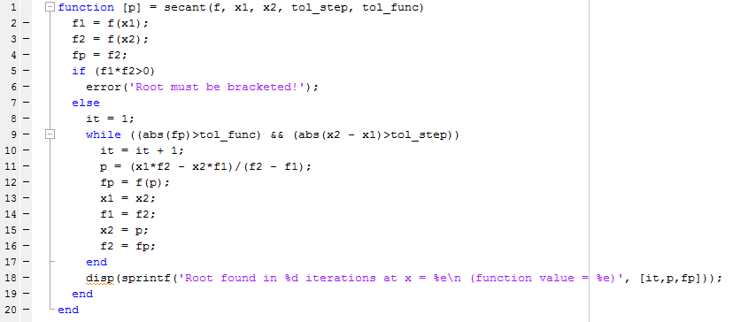
Secant and False position method
Exercise 3: Secant method in MATLAB
The only difference with False position method!
Secant method: 8 iterations False position: 12 iterations Bisection: 25 iterations
>> secant(@(x) x^2-4*x+2,0,2,1e-7,1e-7);

Slide 26
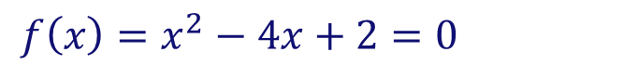
Secant and False position method
Comparison of methods
$$f\left(x\right)=x^{2}−4x+2=0$$
tol_eps, tol_func = 1e-15, and (x₁, x₂) = (0,2)
Method
Nr. iterations
Bisection
52
False position
22
Secant
9
Compare with:
>> fzero(@(x) x^2-4*x+2,2,optimset('TolX',1e-15,'Display','iter'))
Note the initial bracketing steps in fzero!

Slide 27

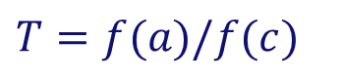
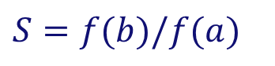
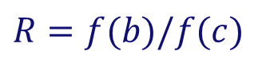
Brent’s method
Superlinear convergence + sureness of bisection
Keep track of superlinear convergence, and if not, intersperse with bisection steps (assures at least linear convergence)
Brent’s method (is implemented in MATLAB’s fzero): root-bracketing + bisection + inverse quadratic interpolation
Inverse quadratic interpolation: uses 3 prior points to fit an inverse quadratic function (i.e. x(y) ) with contingency plans, if root falls outside brackets:
When P/Q does not land within the bounds or when bounds are not collapsing fast enough ⇒ take bisection step
$$x=b+P/Q$$
$$R=f(b)/f(c)$$
$P=S\left[T\left(R−T\right)\left(c−b\right)−\left(1−R\right)\left(b−a\right)\right]$
$$S=f(b)/f(a)$$
$Q=\left(T−1\right)\left(R−1\right)\left(S−1\right)$
$$T=f(a)/f(c)$$
b = current best estimate P/Q = ought to be a ‘small’ correction

Slide 28
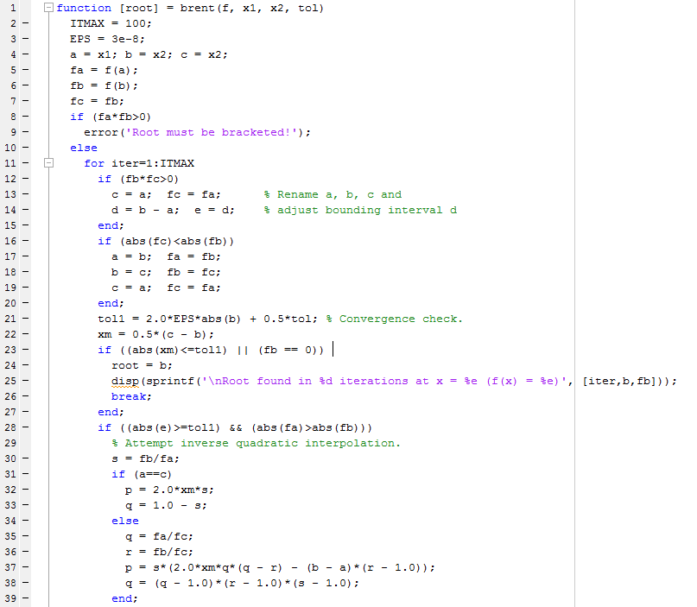
Brent’s method

Slide 29

Brent’s method

Slide 30
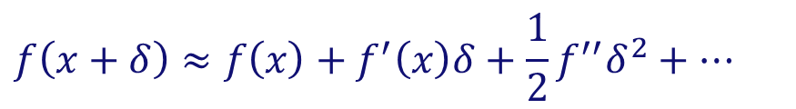
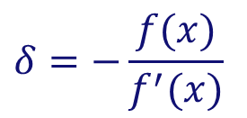
Newton-Raphson method
Requires the evaluation of the function f(x) and the derivative f ′(x) at arbitrary points
Algorithm:
Extend tangent line at current point x_{i} till it crosses zero
Set next guess x_{i+1} to the abscissa of that zero crossing
$$f\left(x+δ\right)≈f\left(x\right)+f^{′}\left(x\right)δ+\frac{1}{2}f^{′′}δ^{2}+…$$
(Taylor series at x)
For small enough values of δ and for well-behaved functions, the non-linear terms become unimportant
$$δ=−\frac{f(x)}{f^{′}(x)}$$
Can be extended to higher dimensions
Requires an initial guess sufficiently close to the root! (otherwise even failure!!)
⇒

Slide 31
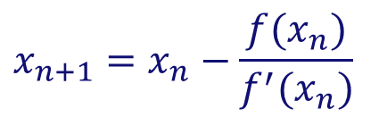
Newton-Raphson method
Example:
f(x)
1
Newton-Raphson method:
$$x_{n+1}=x_{n}−\frac{f(x_{n})}{f^{′}(x_{n})}$$
3
Enormously fast convergence, ….when it works
2
WHEN IT DOES NOT WORK…
1
2

Slide 32
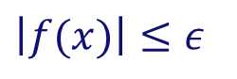
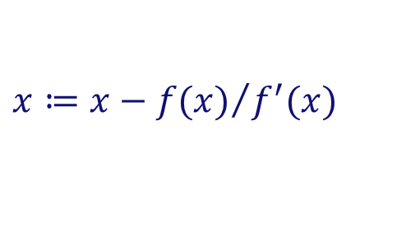
Newton-Raphson method
Basic algorithm:
Given initial x, required tolerance ε > 0
Repeat
Compute f(x) and f′(x).
If , return x
until maximum number of iterations is exceeded
$$\left|f(x)\right|≤ε$$
$$x≔x−{f(x)}/{f^{′}(x)}$$

Slide 33
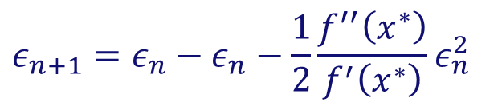
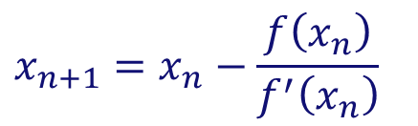
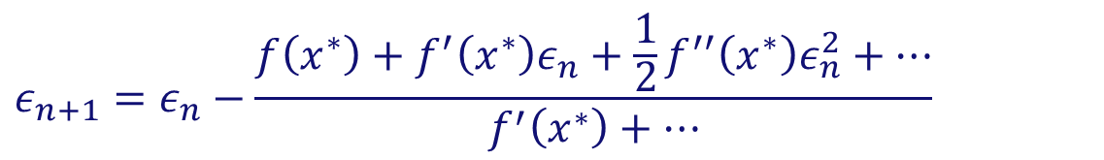
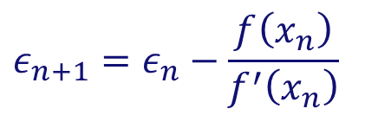

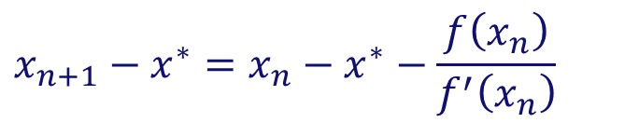
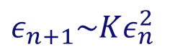
Newton-Raphson method
Why is Newton-Raphson so powerful?
⇒ High rate of convergence
$$x_{n+1}=x_{n}−\frac{f\left(x_{n}\right)}{f^{′}\left(x_{n}\right)}$$
Newton-Raphson method:
$$x_{n+1}−x^{∗}=x_{n}−x^{∗}−\frac{f\left(x_{n}\right)}{f^{′}\left(x_{n}\right)}$$
Subtracting the solution x*:
$$ε_{n+1}=ε_{n}−\frac{f\left(x_{n}\right)}{f^{′}\left(x_{n}\right)}$$
$${ε_{n}=x}_{n}−x^{∗}$$
Defining the error :
$$ε_{n+1}=ε_{n}−\frac{f\left(x^{∗}\right)+f^{′}\left(x^{∗}\right)ε_{n}+\frac{1}{2}f^{′′}\left(x^{∗}\right)ε_{n}^{2}+…}{f^{′}\left(x^{∗}\right)+…}$$
$$ε_{n+1}=ε_{n}−ε_{n}−\frac{1}{2}\frac{f^{′′}\left(x^{∗}\right)}{f^{′}\left(x^{∗}\right)}ε_{n}^{2}$$
$$ε_{n+1}\sim Kε_{n}^{2}$$
⇒
Quadratic convergence!!

Slide 34
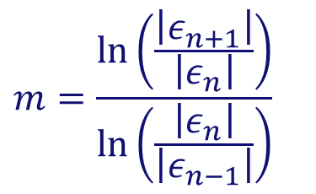
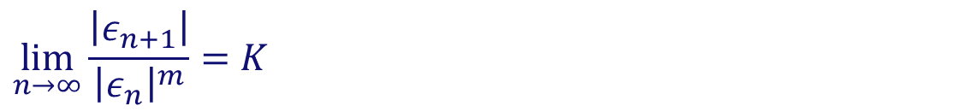
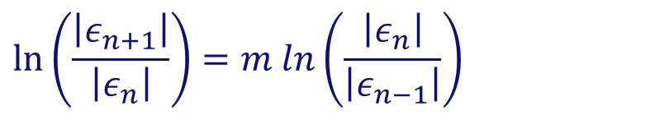
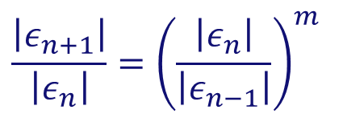
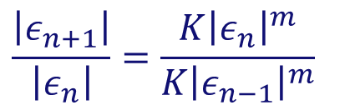

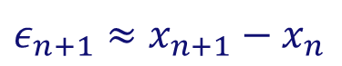
Newton-Raphson method
Order of convergence
$$\lim_{n→∞}{\frac{\left|ε_{n+1}\right|}{{\left|ε_{n}\right|}^{m}}=K}$$
m = order of convergence K = asymptotic error constant
$$ε_{n}=x_{n}−x^{∗}$$
with x* the solution
When the solution is not known a priori:
$$ε_{n+1}≈x_{n+1}−x_{n}$$
$$\frac{\left|ε_{n+1}\right|}{\left|ε_{n}\right|}=\frac{K{\left|ε_{n}\right|}^{m}}{K{\left|ε_{n−1}\right|}^{m}}$$
$$\frac{\left|ε_{n+1}\right|}{\left|ε_{n}\right|}={\left(\frac{\left|ε_{n}\right|}{\left|ε_{n−1}\right|}\right)}^{m}$$
⇒
$$m=\frac{\ln\left(\frac{\left|ε_{n+1}\right|}{\left|ε_{n}\right|}\right)}{\ln\left(\frac{\left|ε_{n}\right|}{\left|ε_{n−1}\right|}\right)}$$
$$\ln\left(\frac{\left|ε_{n+1}\right|}{\left|ε_{n}\right|}\right)=m ln\left(\frac{\left|ε_{n}\right|}{\left|ε_{n−1}\right|}\right)$$
⇒
for n → ∞

Slide 35
Newton-Raphson method
Exercise 4:
Write a function in MATLAB to find a root of a function using the Newton-Raphson method
Assume that an initial guess x₀ is provided
Also the required tolerance is given
Output the results for every iteration
Verify that at every iteration the number of significant digits double, and compute the order of convergence

Slide 36

Newton-Raphson method
Exercise 4: Newton-Raphson in MATLAB
>> newton1D(@(x) x^2-4*x+2, @(x) 2*x-4,1,1e-12,1e-12)
Convergence in 6 iterations. Why does it not work with an initial guess of x₀ = 2??

Slide 37
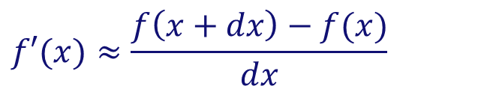
Newton-Raphson method
Modifications to the basic algorithm
If the first derivative f ′(x) is not known or cumbersome to compute/program, we can use the local num. approximation:
Unless you know that the initial guess is close to the solution, the Newton-Raphson method should be combined with:
a bracketing method, to reject the solution if it wanders outside of the bounds;
Reduced Newton step method (= relaxation) for more robustness. Don’t take the entire step if the error does not decrease (enough)
More sophisticated step size control: Local line searches and backtracking using cubic interpolation (for global convergence)
$$f′(x)≈\frac{f\left(x+dx\right)−f(x)}{dx}$$
(dx ~ 10⁻⁸)
dx should be small (otherwise the method reduces to first order)
But not too small (otherwise you will be wiped out by roundoff!)

Slide 38
Newton-Raphson method
How to solve:
One dimensional case:
“Bracket or ‘trap’ a root between bracketing values, then hunt it down like a rabbit.”
Multi-dimensional case:
N equations in N unknowns: You can only hope to find a solution. It may have no (real) solution, or more than one solution!
Much more difficult!! “You never know whether a root is near, unless you have found it”
$$f\left(x\right)=0$$
for arbitrary functions f
“Root finding”
(i.e. move all terms to the left)
$$f\left(x\right)=0$$
$$f\left(x\right)=0$$

Slide 39
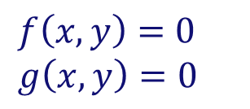
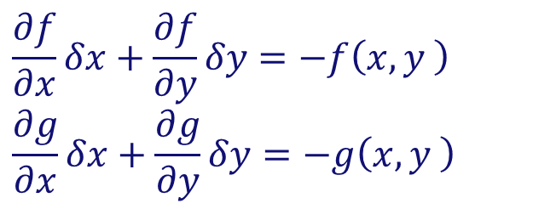
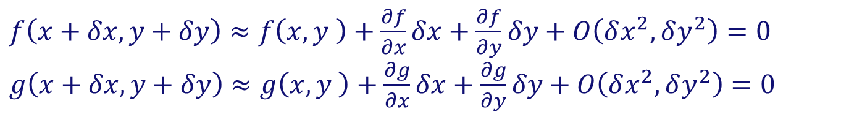
Newton-Raphson method
Extensions to multi-dimensional case:
Let’s first consider the two-dimensional case:
$f\left(x,y\right)=0$
$g\left(x,y\right)=0$
Multi-variate Taylor series expansion:
$f\left(x+δx,y+δy\right)≈f\left(x,y \right)+\frac{∂f}{∂x}δx+\frac{∂f}{∂y}δy+O\left(δx^{2},δy^{2}\right)=0$
$g\left(x+δx,y+δy\right)≈g\left(x,y \right)+\frac{∂g}{∂x}δx+\frac{∂g}{∂y}δy+O\left(δx^{2},δy^{2}\right)=0$
Neglecting higher order terms:
$$\frac{∂f}{∂x}δx+\frac{∂f}{∂y}δy=−f\left(x,y \right)$$
$$\frac{∂g}{∂x}δx+\frac{∂g}{∂y}δy=−g\left(x,y \right)$$
Two linear equations in the two unknowns δx and δy.
⇒

Slide 40
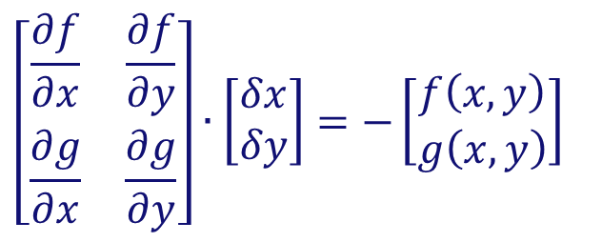
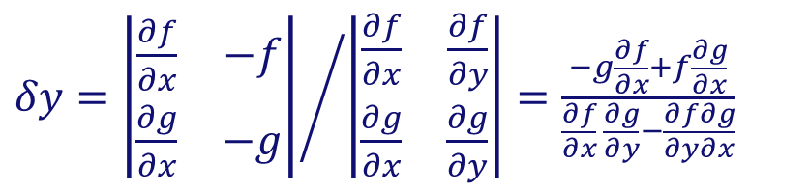
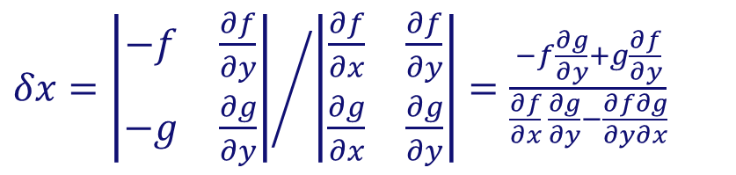
Newton-Raphson method
Extensions to multi-dimensional case:
Newton-Raphson method:
Or in matrix notation:
$$\frac{∂f}{∂x}δx+\frac{∂f}{∂y}δy=−f\left(x,y \right)$$
$$\frac{∂g}{∂x}δx+\frac{∂g}{∂y}δy=−g\left(x,y \right)$$
$$\left[\begin{matrix}\frac{∂f}{∂x} & \frac{∂f}{∂y} \\ \frac{∂g}{∂x} & \frac{∂g}{∂y}\end{matrix}\right]∙\left[\begin{matrix}δx \\ δy\end{matrix}\right]=−\left[\begin{matrix}f\left(x,y\right) \\ g\left(x,y\right)\end{matrix}\right]$$
Solution via Cramer’s rule:
Jacobian matrix
$δx={\left|\begin{matrix}−f & \frac{∂f}{∂y} \\ −g & \frac{∂g}{∂y}\end{matrix}\right|}/{\left|\begin{matrix}\frac{∂f}{∂x} & \frac{∂f}{∂y} \\ \frac{∂g}{∂x} & \frac{∂g}{∂y}\end{matrix}\right|=\frac{−f\frac{∂g}{∂y}+g\frac{∂f}{∂y}}{\frac{∂f}{∂x} \frac{∂g}{∂y}−\frac{∂f}{∂y}\frac{∂g}{∂x}}}$
$δy={\left|\begin{matrix}\frac{∂f}{∂x} & −f \\ \frac{∂g}{∂x} & −g\end{matrix}\right|}/{\left|\begin{matrix}\frac{∂f}{∂x} & \frac{∂f}{∂y} \\ \frac{∂g}{∂x} & \frac{∂g}{∂y}\end{matrix}\right|=\frac{−g\frac{∂f}{∂x}+f\frac{∂g}{∂x}}{\frac{∂f}{∂x} \frac{∂g}{∂y}−\frac{∂f}{∂y}\frac{∂g}{∂x}}}$

Slide 41
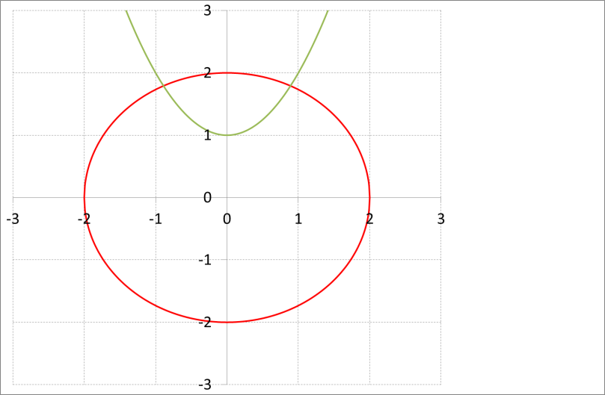
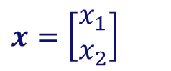
























Newton-Raphson method
Extensions to multi-dimensional case:
Example: intersection of circle with parabola:
In matrix form:
$$x^{2}+y^{2}=4$$
⇒
$$f=\left[\begin{matrix}f_{1} \\ f_{2}\end{matrix}\right]=\left[\begin{matrix}x_{1}^{2}+x_{2}^{2}−4 \\ x_{1}^{2}−x_{2}+1\end{matrix}\right]$$
$$x=\left[\begin{matrix}x_{1} \\ x_{2}\end{matrix}\right]$$
$J=\left[\begin{matrix}2x_{1} & 2x_{2} \\ 2x_{1} & −1\end{matrix}\right]$
$${y=x}^{2}+1=0$$
$$x^{(i)}$$
$$f^{(i)}$$
$$J^{(i)}$$
$${δx}^{(i)}$$
$$\left[\begin{matrix}1 \\ 2\end{matrix}\right]$$
$\left[\begin{matrix}2 & 4 \\ 2 & −1\end{matrix}\right]$
i = 1:
$$\left[\begin{matrix}1 \\ 0\end{matrix}\right]$$
$\left[\begin{matrix}−0.1 \\ −0.2\end{matrix}\right]$
$$\left[\begin{matrix}0.9 \\ 1.8\end{matrix}\right]$$
$\left[\begin{matrix}1.8 & 3.6 \\ 1.8 & −1\end{matrix}\right]$
i = 2:
$$\left[\begin{matrix}0.05 \\ 0.01\end{matrix}\right]$$
$\left[\begin{matrix}−0.01039 \\ −0.0087\end{matrix}\right]$
$$\left[\begin{matrix}0.889614 \\ 1.791304\end{matrix}\right]$$
$\left[\begin{matrix}1.7792 & 3.5826 \\ 1.7792 & −1\end{matrix}\right]$
i = 3:
$$\left[\begin{matrix}0.000183 \\ 0.0000108\end{matrix}\right]$$
$\left[\begin{matrix}−6.99∙{10}^{−5} \\ −1.65∙{10}^{−5}\end{matrix}\right]$
$$\left[\begin{matrix}0.8895436 \\ 1.7912878\end{matrix}\right]$$
$\left[\begin{matrix}1.779087 & 3.582576 \\ 1.779087 & −1\end{matrix}\right]$
i = 4:
$$\left[\begin{matrix}5.16∙{10}^{−9} \\ 4.89∙{10}^{−9}\end{matrix}\right]$$
$\left[\begin{matrix}−2.78∙{10}^{−9} \\ −5.94∙{10}^{−11}\end{matrix}\right]$

Slide 42


Newton-Raphson method
Extensions to multi-dimensional case:
Example: intersection of circle with parabola:
Check order of convergence:
Quadratic convergence! = doubling number of significant digits every iteration
$$ε_{n+1}≈x_{n+1}−x_{n}$$
$$m=\frac{\ln\left(\frac{\left|ε_{n+1}\right|}{\left|ε_{n}\right|}\right)}{\ln\left(\frac{\left|ε_{n}\right|}{\left|ε_{n−1}\right|}\right)}$$

Slide 43









Newton-Raphson method
Extensions to multi-dimensional case:
Generalization to the N-dimensional case:
$$f_{i}\left(x_{1},x_{2},…,x_{N}\right)=0$$
for i = 1, 2, …, N
Define:
$$x=\left[x_{1},x_{2},…,x_{N}\right]$$
$$f\left(x\right)=0$$
and
$$f=\left[f_{1},f_{2},…,f_{N}\right]$$
⇒
Multi-variate Taylor series expansion:
$$f_{i}\left(x+δx\right)=f_{i}\left(x\right)+\sum_{j=1}^{N}{\frac{∂f_{i}}{∂x_{j}}δx_{j}}+O\left(δx^{2}\right)$$
Define Jacobian matrix:
$$J_{ij}=\frac{∂f_{i}}{∂x_{j}}$$
⇒
$$f\left(x+δx\right)=f\left(x\right)+J∙δx+O\left(δx^{2}\right)$$
$$J∙δx=−f\left(x\right)$$
Neglect higher order terms:
$$x_{new}=x_{old}+δx$$

Slide 44



Newton-Raphson method
Multi-variate Newton-Raphson in MATLAB
Solve A⁻¹·b simply with “A\b”
This is the strength of MATLAB!
>> newton(@MyFunc,@MyJac,[1;2],1e-12,1e-12)

Slide 45

Newton-Raphson method
Multi-variate Newton-Raphson in MATLAB
Plotting the functions:
>> mphandle = mupad

Slide 46

Newton-Raphson method
Multi-variate Newton-Raphson in MATLAB
Plotting the norm of the function:

Slide 47

Newton-Raphson method
Multi-variate Newton-Raphson in MATLAB
Plotting contours of the norm of the function:

Slide 48





Broyden’s method
Multi-dimensional secant method (‘quasi-Newton’):
Disadvantage of the Newton-Raphson method:
It requires the Jacobian matrix
In many problems no analytical Jacobian available
If the function evaluation is expensive, the numerical approximation using finite differences can be prohibitive!
⇒
use cheap approximation of the Jacobian!
(= secant, or ‘quasi-Newton’ method)
Newton-Raphson:
Secant method:
$$J^{n}∙δx^{n}=−f^{n}\left(x^{n}\right)$$
$$B^{n}$$
= approximation of the Jacobian
$$B^{n}∙δx^{n}=−f^{n}\left(x^{n}\right)$$
$$x^{n+1}=x^{n}+δx^{n}$$
$$x^{n+1}=x^{n}+δx^{n}$$

Slide 49




Broyden’s method
Multi-dimensional secant method (‘quasi-Newton’):
Secant equation (generalization of 1D case):
$$B^{n+1}∙δx^{n}=δf^{n}$$
$$δx^{n}=x^{n+1}−x^{n}$$
$$δf^{n}=f^{n+1}−f^{n}$$
Underdetermined (i.e. not unique: n equations with n² unknowns ) ⇒ we need another condition to pin down B^{n+1}
Broyden’s method: determine B^{n+1} by making the least change to B^{n} that is consistent with the secant condition
$$B^{n+1}=B^{n}+\frac{\left(δf^{n}−B^{n}∙δx^{n}\right)}{δx^{n}∙δx^{n}}⨂δx^{n}$$
Updating formula:
(Note: sometimes B⁻¹ is updated directly)

Slide 50






Broyden’s method
Multi-dimensional secant method (‘quasi-Newton’):
Background of Broyden’s method:
Secant equation:
$$B^{n+1}∙δx^{n}=δf^{n}$$
Broyden’s method: Since there is no update on derivative info, why would B^{n} change in a direction w orthogonal to
$$δx^{n}$$
⇒
$${\left(δx^{n}\right)}^{T}w=0$$
$$B^{n+1}∙w=B^{n}∙w$$
$$B^{n+1}=B^{n}+\frac{\left(δf^{n}−B^{n}∙δx^{n}\right)}{δx^{n}∙δx^{n}}⨂δx^{n}$$
⇒
$$B^{n+1}∙δx^{n}=δf^{n}$$
Initialize B⁰ with identity matrix (or with finite difference approx.)

Slide 51

Broyden’s method
Same example as before but now with Broyden’s method
Slower convergence with Broyden’s method should be offset by improved efficiency of each iteration!
>> broyden(@MyFunc,[1;2],1e-12,1e-12)
Requires 12 iterations (compare with Newton: 5 iterations)
But much fewer function evaluations per iteration!

Slide 52
Conclusions
Recommendations for root finding:
One-dimensional cases:
If it is not easy/cheap to compute the function’s derivative ⇒ use Brent’s algorithm
If derivative information is available ⇒ use Newton-Raphson’s method + bookkeeping on bounds provided you can supply a good enough initial guess!!
There are specialized routines for (multiple) root finding of polynomials (but not covered in this course)
Multi-dimensional cases:
Use Newton-Raphson method, but make sure that you provide an initial guess close enough to achieve convergence
In case derivative information is expensive ⇒ use Broyden’s method (but slower convergence!)

